Slide 1
Important Terminologies
Code, Content, Stimulus, Response, Speech & Personality, Pronunciation Etiquette, Speaking with Purpose

Slide 2
Unit V- Dimensions of Oral Communication & Voice Dynamics
Paralinguistic Features- Quality, Volume, Rate of Speech, etc.
Dimensions of Speech –
Syllables- Definition and types
Intonation – Definition and types (Rising and Falling Tone)
Stress - Definition and types
Process of Communication – Encoding, Decoding, etc.
Phonetics – Vowel Sounds, Consonant Sounds, Phonetic Transcription
Code & Content
Stimulus & Response
Professional Personality Attributes
Speaking with a purpose
Speech and personality
Topics ‘A’ to ‘C’ to be studied from First Year notes.
Topics ‘D’ to ‘I’ to be studied from Second Year class notes

Slide 3
Topics Covered
Code & Content
Stimulus & Response
Speaking with a Purpose
Speech and Personality
Pronunciation Etiquette

Slide 4
A. Code & Content
Any human communication system involves the production of a message by someone, and the receipt of that message by someone else.
To encode a message, one must possess the necessary encoding skills.
Languages are codes.
A code may be defined as any group of symbols that can be structured in a way that is meaningful to another person.
Code is a system of rules to convert information into another form or representation.
The English language, like any other language, is a code—it contains element that are arranged in a meaningful order.

Slide 5
Code & Content……contd.
A code has a group of elements (vocabulary) and a set of procedures for combining these elements meaningfully (grammar).
Next is the message content, i.e., the message that is selected by the source to express its purpose.
Content in communication means any text matter of a document or publication in any form.
It can be defined as what is inside or included in something.
Content, like codes, has both element and structure.
When more than one piece of information is to be presented, they should have some order or structure.

Slide 6
B. Stimulus & Response of Communication Skills
A ‘stimulus’ is anything that a person can receive through one of his senses.
In fact, it is anything that can produce a sensation.
A ‘response’ is anything that an individual does as a reaction to the stimulus.
These two terms, stimulus and response, are ultimately connected with the whole learning process.
The communication objective of the source is to bring about a change in the behaviour of the receiver.

Slide 7
Stimulus and Response of Communication Skills
The whole communication process consists of the following:
The sender—the source of the message
The encoding process
The channel used
The decoding process
The receiver—the person who receives the message
At each stage of the communication process depicted there is a possibility of error (Barriers). Communication skills help avoid such errors, so that the message can glide easily through all the stages of the process and reach the receiver.

Slide 8
a. Source
The source is the most critical part of the communication process.
The message has to be planned and prepared for features including articulation clarity, amplitude and modulation, pauses and pitch.
The sender must be conscious that non-verbal components of the communication are also transmitted through the channel.
The source of the message has great responsibility. He should have an idea about the receiver. It may be also that he wants to convey his message to a group of persons.
Finally, at the end of the communication, he must satisfy himself that the intent of the communication has been met.

Slide 9
b. The Encoding Process
As language is a code, the encoding process is of vital importance.
What the sender wants to convey must be encoded correctly.
He must have a good vocabulary and good knowledge of grammar and syntax.
Any flaw might distort the meaning of the message he wants to convey.

Slide 10
c. The Channel
Messages are conveyed through various channels.
Any written communi­cation such as emails, organization memos and formal letters are examples of channels.
Face-to-face meetings, video conferencing, telephonic conversa­tion, PC-to-PC communication, .webcast etc., are different communication channels.

Slide 11
d. The Decoding Process
Just as successful encoding is a skill, so is successful decoding.
Here the person decoding the message through a particular channel such as a letter, e-mail, telephone, etc., must be capable of deciphering or understanding that message.
He must have enough knowledge to understand that message.

Slide 12
e. The Receiver
The person receiving the message should be prepared for the message.
At times visual reaction to a message takes on the role of a sender and responds.
At other times, the receiver of the message may show his visual reaction to the message through non-verbal communication

Slide 13
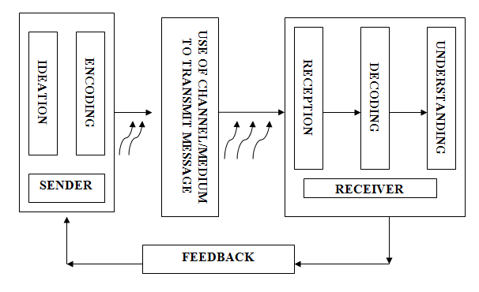
Process - Diagram

Slide 14
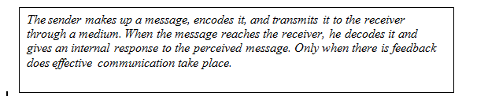
Process - Components
Elements
Sender
Message
Medium
Receiver
Feedback
Stages
Ideation
Encoding
Transmission
Reception
Decoding
Feedback

Slide 15
C. Speaking With a Purpose
Purpose of any speech plays an important part in planning the delivery.
It determines the content and the style of the speech.
Depending on the purpose, any speech should be flexible enough to adjust new inputs and unexpected audience reaction.
Purpose of speech could be -
To inform.
To persuade.
To analyse.
To entertain.
To motivate.

Slide 16
Tips Of Speaking Passionately And With A Purpose
Before you speak, or write, take a second to pause and reflect on what your goal is.
Try to choose the most direct way to say what needs to be said.
Refuse to say umm, ahh or any other filler at any point. Take as much time as you need, just own every second you take.
If writing, read what you wrote before sending it. If it doesn’t flow easily when reading it, it needs to be re-written.

Slide 17
Tips Of Speaking Passionately And With A Purpose
Read books and pay attention. When you hear something that sounds good to your ear, take note of it.
Take things one step at a time. Your goal is not to be a new man by tomorrow morning, it’s to become a bit of a better writer (or speaker) every day.
Use inclusive language for which apply “You-attitude”.
Adapt to the feedback you see from the audience.

Slide 18
D. Speech & Personality
In every aspect of our life, a good personality holds a very important value.
Whether you are a budding professional, an established career person, or perhaps a home-maker, it is something that will help you develop and maintain solid relationships with others.
One of the key facets of personality development is speech. This is the ability of a person to effectively communicate verbally.
Some people are gifted with verbal communication skills, while others are simply to shy and unsure of their abilities to even want to try.
Speech is important in so many ways; be it at home, at school, or at the workplace, you need to be able to articulate well the thoughts and ideas you have.

Slide 19
Speech & Personality
What we say about others reflects on our own character.
Specifically, when we speak unfavorably of others, it not only hurts the person our words are aimed at, but it also damages our credibility and reputation in the process.
Richard Carlson put it this way: ” When we judge or criticize another person, it says nothing about that person; it merely says something about our own need to be critical.”
In personality development, the importance of speech is summed up into two: perception and expression.

Slide 20
Speech & Personality……………contd.
Perception - Gaining Positive Perception from Others
Our perception of others can be influenced by the way they speak and the message they are trying to relay.
This is one of the reasons why speech is very important in personality development.
If we are careful with our speech, whether formal or informal, we can gain a positive perception from our peers, colleagues, and our superiors.
If we are fond of using negative words, for example, people will tend to think that we have a bad personality.
On the other hand, if we talk with grace, finesse, and confidence, then it is common for others to perceive us as someone with a pleasing personality.

Slide 21
Speech & Personality……………contd.
Expression - Putting Into Words Our Thoughts and Ideas through Oral Expression
It is very difficult to improve our personality if we cannot even verbalize what it is we want to say.
If we hesitate to speak on fear of being misjudged by others, if we are too shy and scared to open our mouth in a gathering, it will really be difficult for us to develop our personality.
Part of our development is derived from what we learn from others, but if we have poor oral communication skills and refuse to do something about it, then we are blocking the doors for growth.
Being able to express ourselves through speech is essential to build relationships with people, but if we keep on holding back and decline any opportunity to improve, then nothing good will ever come out of it.

Slide 22
E. Pronunciation Etiquette
Make eye contact while speaking. This will not only give you confidence, but will also inspire others to listen to you.
Try to make your voice sound pleasing and soft.
Don’t speak in a monotonous voice; this might have a soporific effect on the audience. Change the modulation of your voice occasionally.
Even if you feel nervous, never show it to the audience; just slow down your speech and remain calm.
Don’t mumble. Speak clearly.

Slide 23
Pronunciation Etiquette…………contd.
Use words the meanings of which are absolutely clear to you. This might save you from any embarrassment later.
Use proper body language to show your interest in the ongoing conversation.
At the end of the conversation, don’t forget the customary etiquette of thanking the audience for listening to you patiently.
All through the duration of a conversation, never do the following: think in your mother tongue what you want to say, then mentally translate it into English and finally speak in English. This will spoil the flow of your speech.

Slide 24
THANKS

